Slide 1
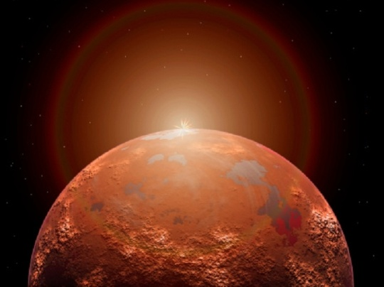
Mission Mars
Should colonize Mars?
By Quang Huynh, Dominic Getman, and Benjamin Gorman

Slide 2
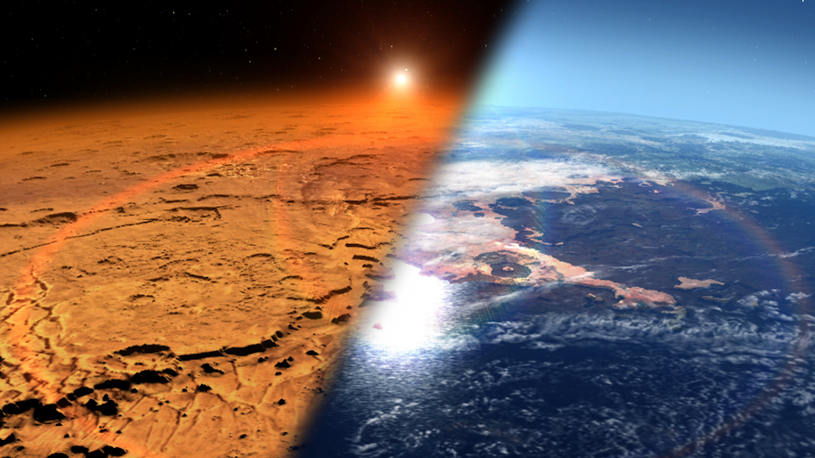
Checkpoint One
The surface of Mars has physical features, such as on Mars, there are many rocks and the colors of the rocks are mostly red. But compared to Earth, the surface of Mars is different from Earth because the Earth has 75% of the surface covered with water. Earth’s colors include blue, green, white, and brown.

Slide 3
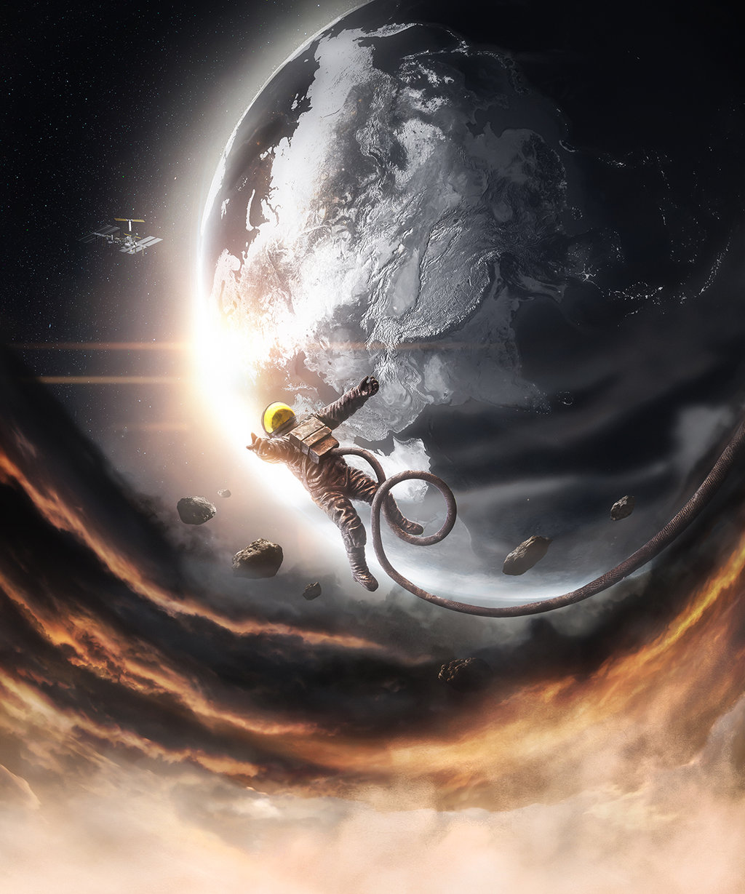
Checkpoint Two
The central idea is that, the gravity on Mars is different to the gravity on Earth, and must meet requirements for reentry. We can confirm this by which that Taylor is 176 pounds on Earth, and is now 66.3 pounds on Mars. Another example is that, Bower was 220 pounds on Earth, but he is 82.9 pounds on Mars. Well, compared to the Earth, the gravity on Earth is stronger than Mars, therefore, humans are heavier on Earth than Mars.

Slide 4
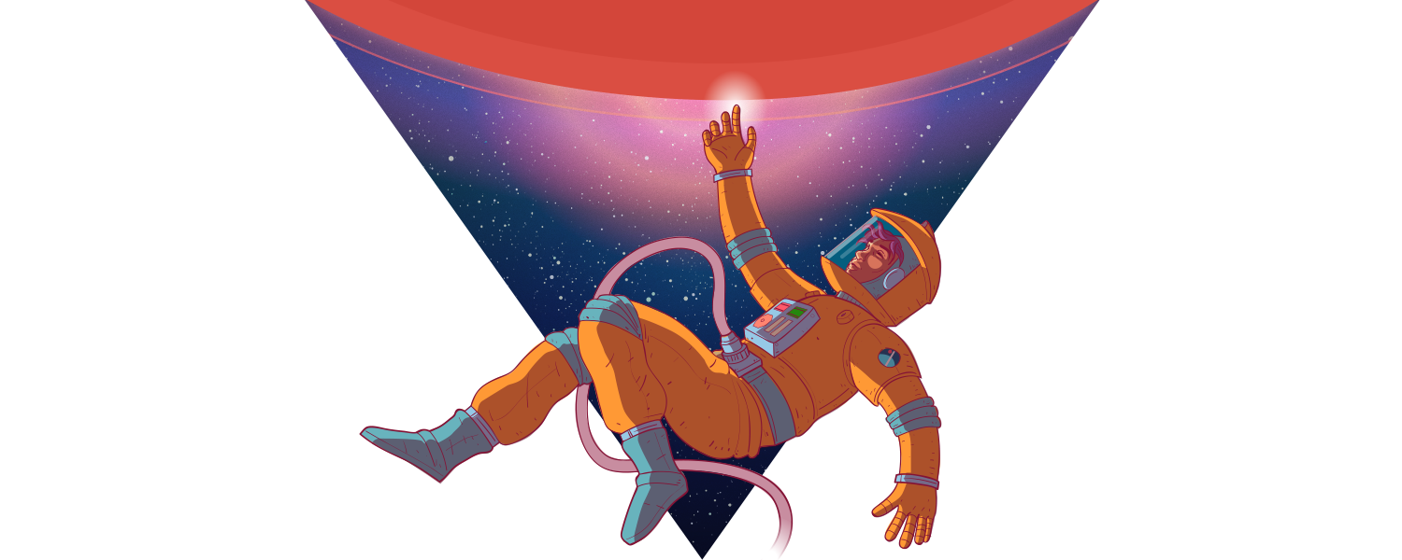
Checkpoint Three
The body is designed to live on Earth, and when we go to space, the body starts to change. My evidence is that, when we go to space, the spine gets lengthened, and due to this, the astronauts get a little bit taller in space. But on Earth, the human body is adjusted to live on the Earth, and the result is, no change will happen to the human body on Earth.

Slide 5
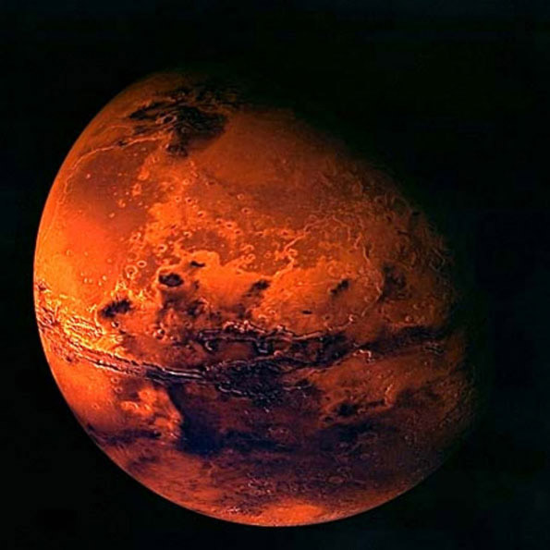
Checkpoint Four
There is a tiny bit of water on Mars, the evidence of this is that, around 4 billion years ago, there was water on Mars’s surface, and now, the result of this was, the water on Mars is buried underneath the Martian surface. Another piece of evidence is, Curiosity’s SAM Instrument finds water on Mars. But on the other hand, the Earth is 70% water on the surface.

Slide 6
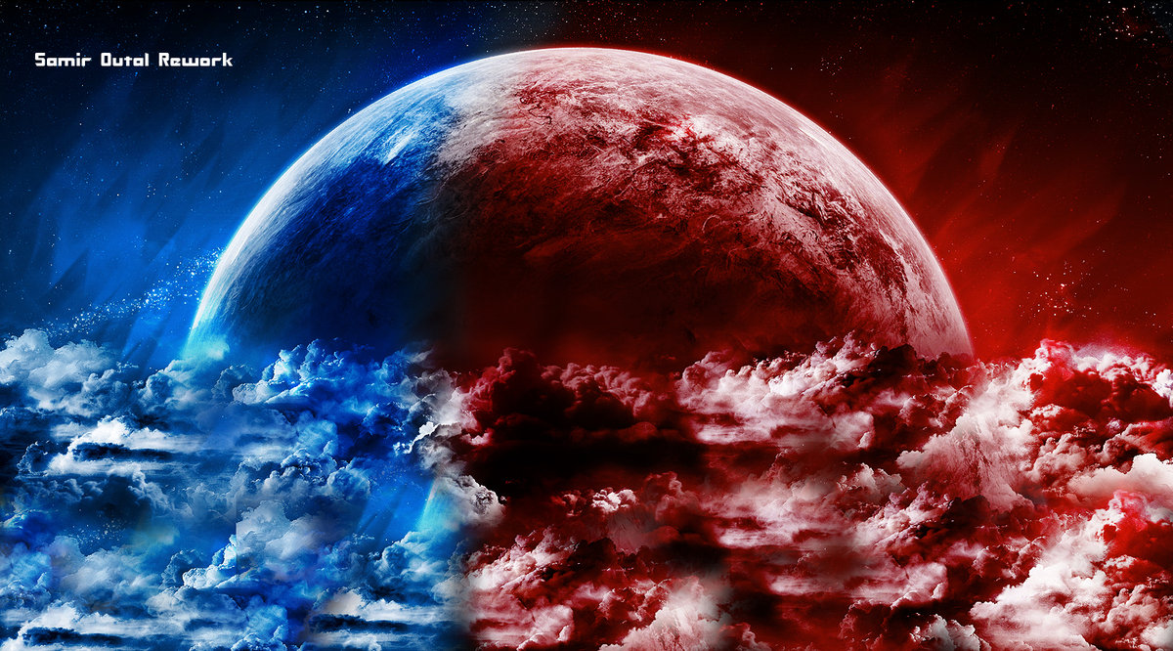
Checkpoint Five
The astronauts have been collecting data about the daily temperature on Mars, and the data suggests that on Sol 10.4, the air temperature is -20°C, and the ground temperature is -40°C. There is totally a difference between Mars and Earth in temperature, the Earth is warmer than Mars.

Slide 7
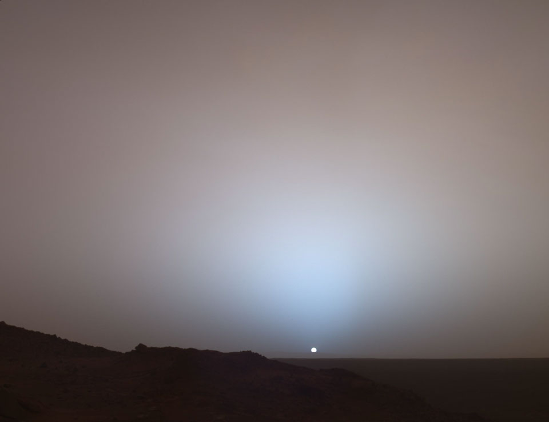
Checkpoint Six
What is the difference between the Earth’s sunset and Mar’s sunset. What is so interesting about Mars’s sunset, is that, it is blue. This is so because blue light is more scattered around the atmosphere. But the sunsets on Earth is red, because there is more red light scattered around the atmosphere.

Slide 8
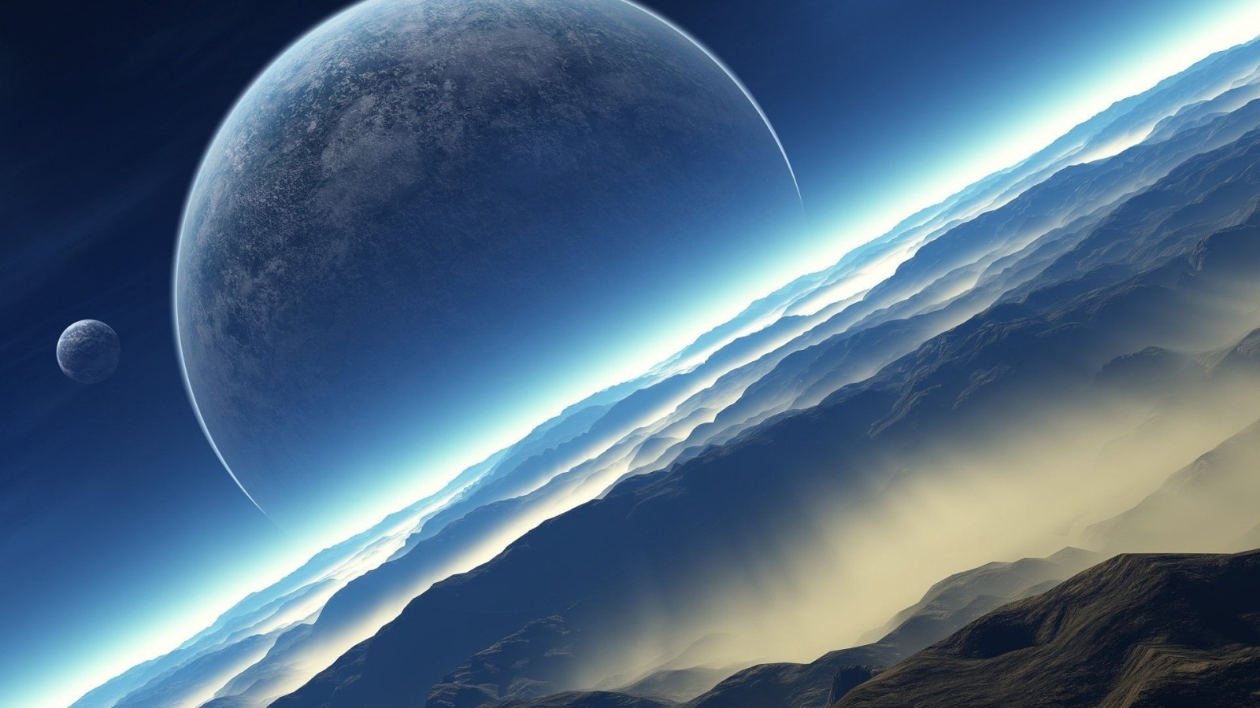
So, in our opinion, we should colonize Mars because Earth could expand out and find more materials and resources on Mars. But the thing is, we do not know if it is safe for our bodies or not, if there is any food or if metal or wood can withstand the climates of Mars.

